Slide 1


Slide 2



Parent workshop – Multiplication and Times Tables

Slide 3
Workshop aims
- National expectations for number facts and times tables (years one to six)
- Year 4 Multiplication Check (MTC)
- Teaching of multiplication and times tables at school
- How to best support your child at school
- Useful resources
- Questions

Slide 4
National Expectations
Year One | Count in multiples of 2, 5 and 10 (i.e. 2, 4, 6, 8)
Year Two | Recall and use times table facts of 2, 5 and 10 (i.e 1 x 2 = 2 and 10 x 6 = 60)
Year Three | Recall and use times table facts of 3, 4 and 8
Year Four | Recall and use times table facts of 6, 7, 9, 11 and 12.
Year Five | Recall and use times table facts from 1 up to 12
Year Six | Recall and use times table facts from 1 up to 12

Slide 5
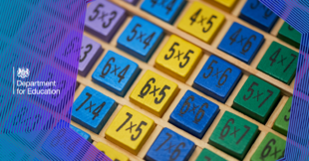
Why are times tables important?
Times Tables are in some ways a skill for life.
They underpin a large portion of the upper key stage two (year five and six) curriculum as well as key stage three and beyond.
There is research that shows understanding times tables is linked to educational achievement, particularly in STEM based subjects.

Slide 6
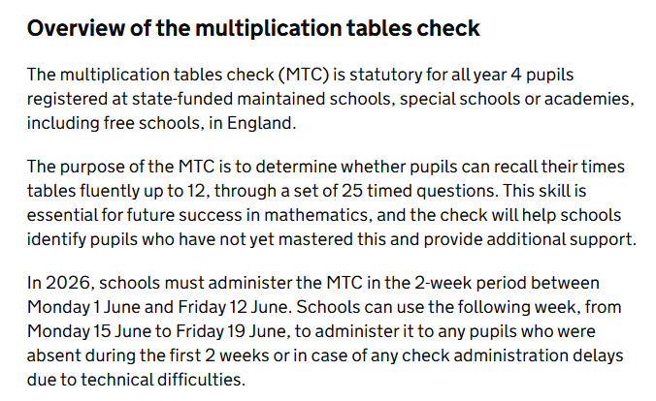
Multiplication Check (MTC)

Slide 7

How do we teach times tables at Heene?
We use the National Centre for Excellence in Teaching Mathematics (NCETM) resources to support maths teaching. In years one and two we use a programme called Mastering Number to deliver arithmetic/fluency practice.
In key stage two, we use a counting stick approach for rote learning of tables.

Slide 8
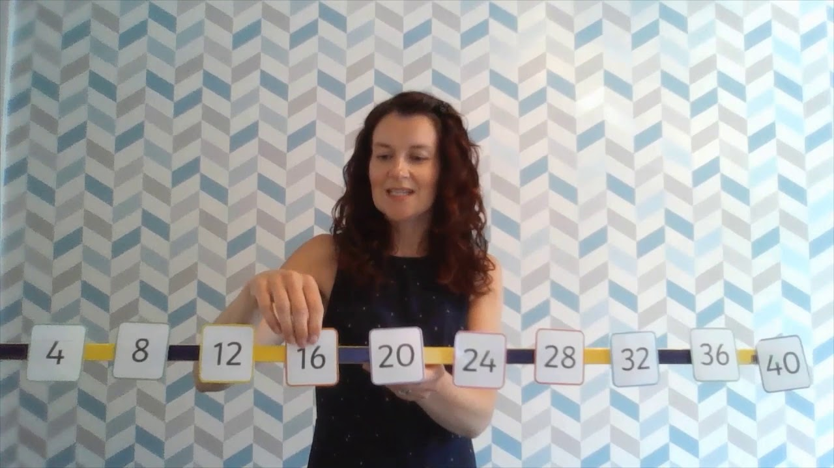
What does the counting stick look like in practice?

Slide 9
Supporting maths learning at home
- There are resources and more information about our maths curriculum on the school website.
- Daily practice, little and often can be very impactful. Five minutes in the morning, ten minutes after school, whatever works for you as parents
- ‘out and about’ – quick fire questions in supermarkets, journeys, etc
- Screen time considerations however there are lots of useful apps (see next slide)

Slide 10
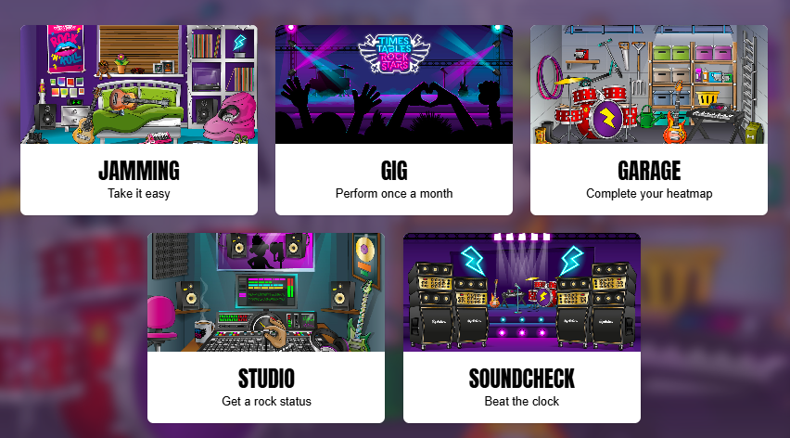
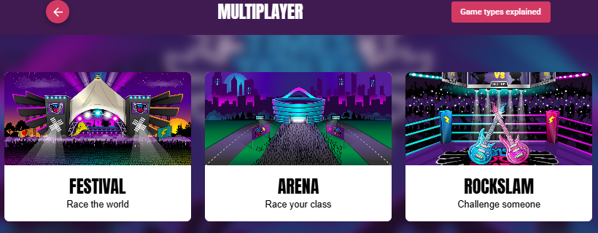
Times Table Rockstars

Slide 11
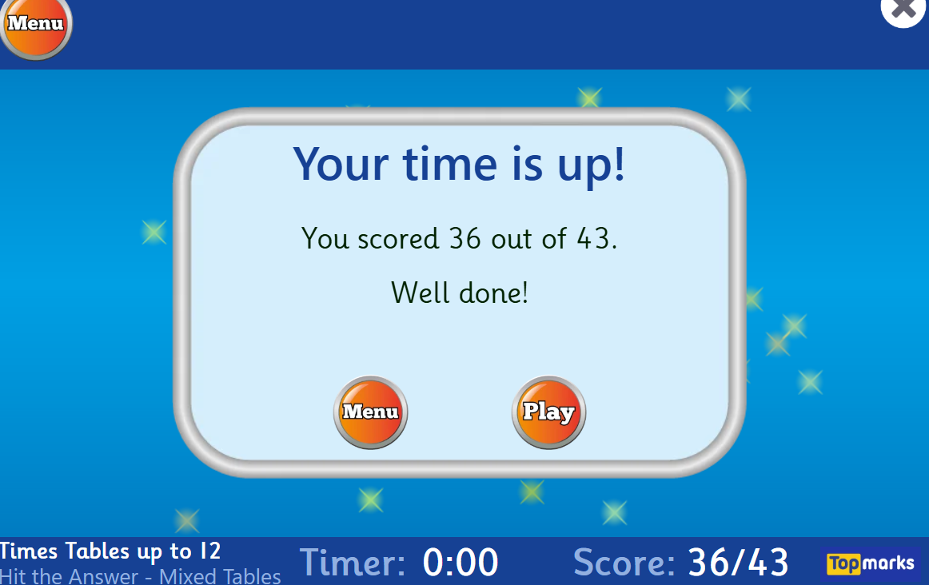
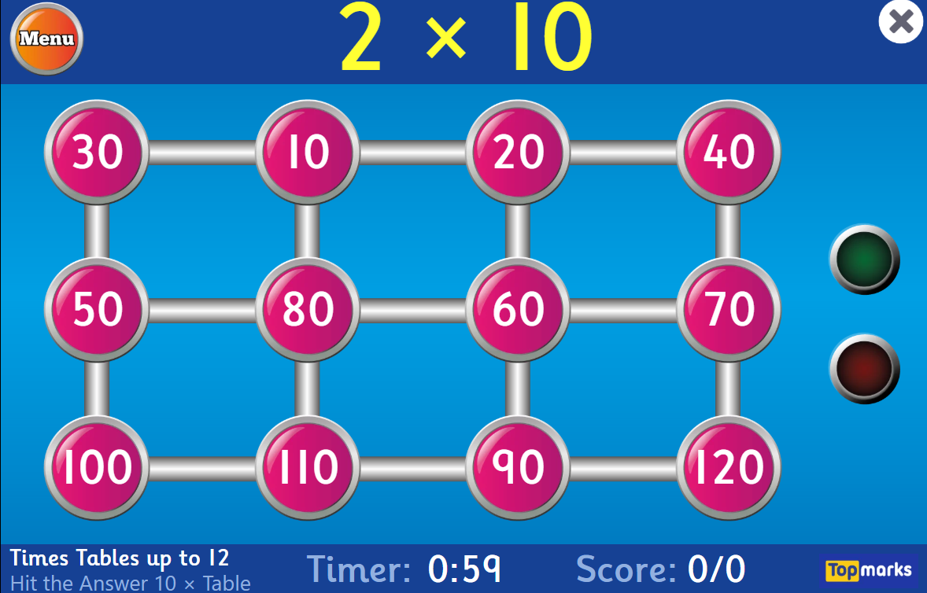
Hit the Button

Slide 12
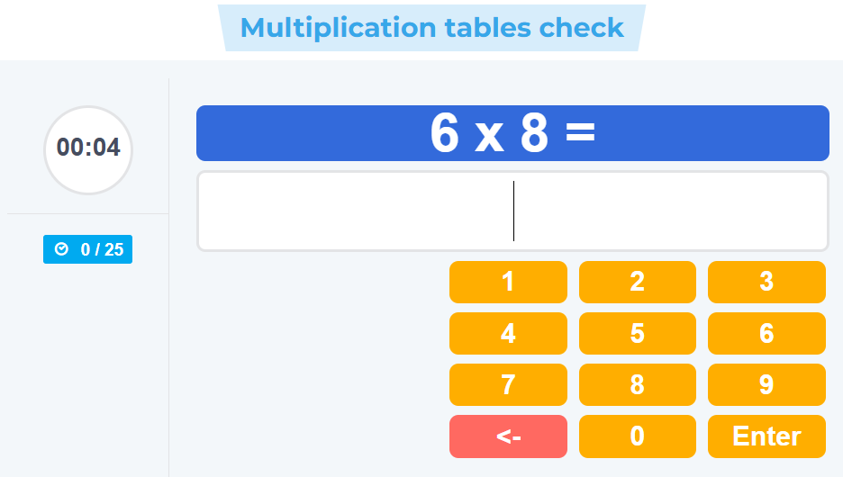

Times Tables

Slide 13
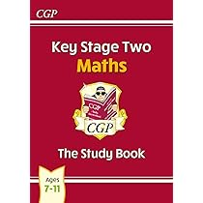



Study and revision books

Slide 14
Reminders…
- Be mindful of screen time.
- Speak with your child’s class teacher if you require further assistance
- Less is more, little and often

